Slide 1

2022 CLIMATE CHANGE BELIEF ANALYSIS
Tweet Sentiment Analysis
2021/22 Climate Change Believe Analysis
Predict an individual sentiment on climate change based on historical tweet data

Slide 2
1. Introduction
2. Problem Overview
3. The Data Science Process
3.1. Data Collection
3.2. Data Cleaning
3.3. Exploratory Data Analysis
3.4. Model Building
3.5. Model Deployment
4. Conclusion
TABLE OF CONTENTS
Team 12
Mpilenhle
Rebecca
Sello
Blessing
Jamie Synders

Slide 3
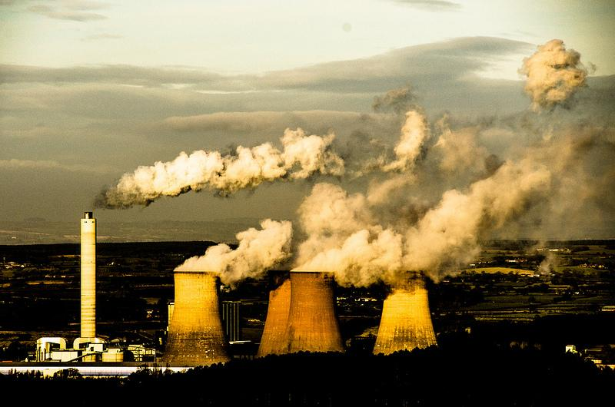
1. INTRODUCTION
CARBON FOOTPRINTS
every service uses dumping
1. Air Pollution
2. Land Pollution
3. Water Pollution
The production Industries are one of the major contributors to the carbon footprint

Slide 4
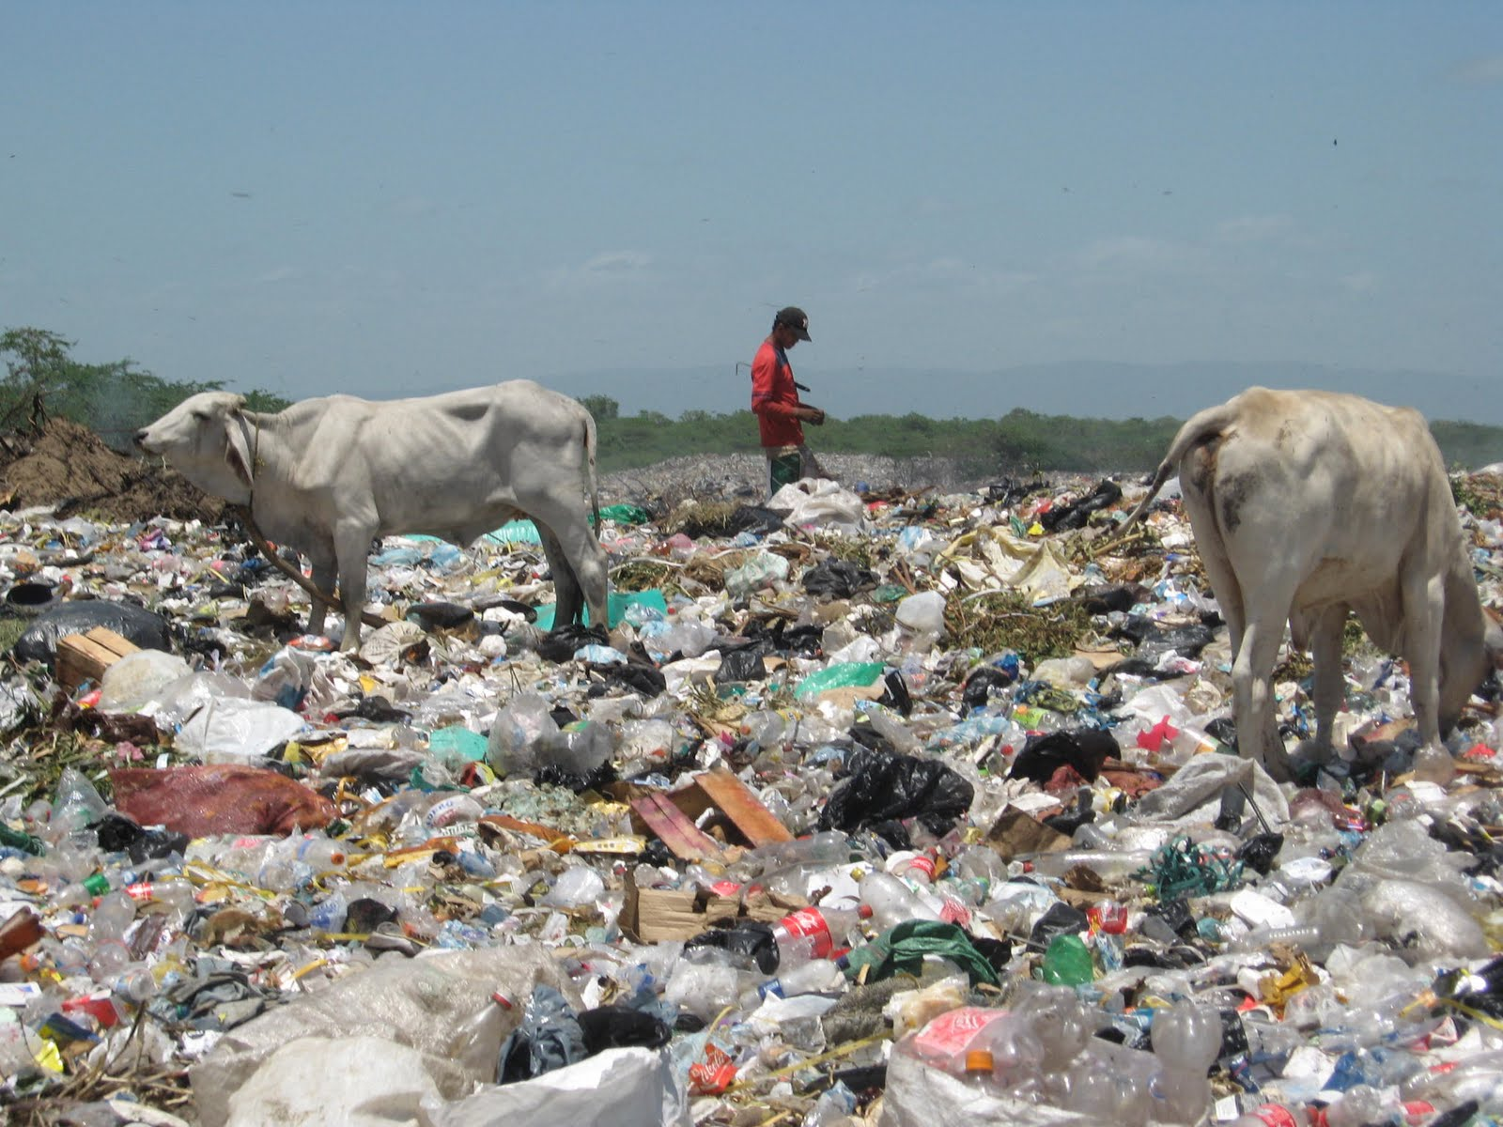
1. INTRODUCTION
CARBON FOOTPRINTS
1. Air Pollution
2. Land Pollution
3. Water Pollution
9% recycled, 12% burnt and 79% landfills, if not home

Slide 5
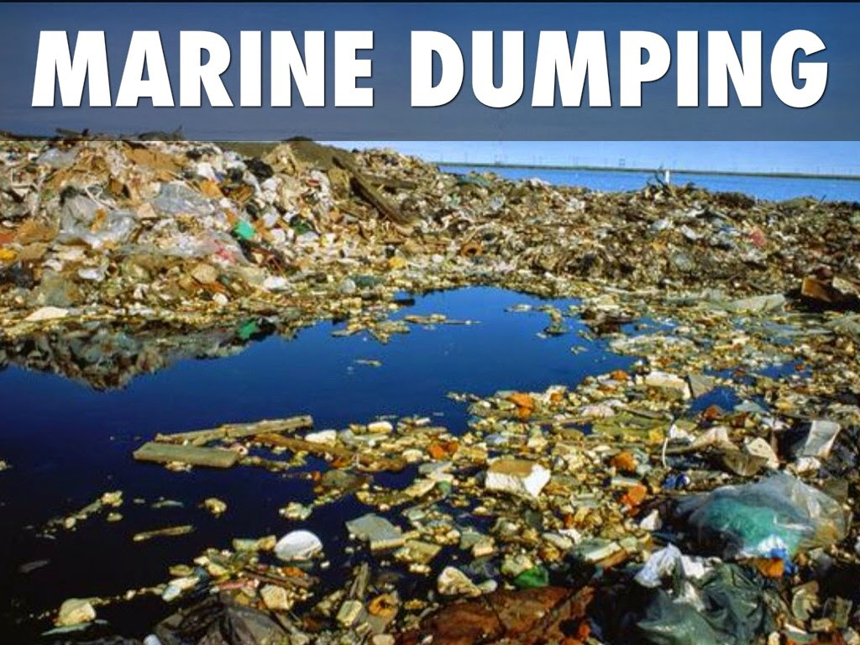
1. INTRODUCTION
CARBON FOOTPRINTS
1. Air Pollution
2. Land Pollution
3. Water Pollution
The sea is has become the most dangerous of places even for the marine life, because of acid

Slide 6
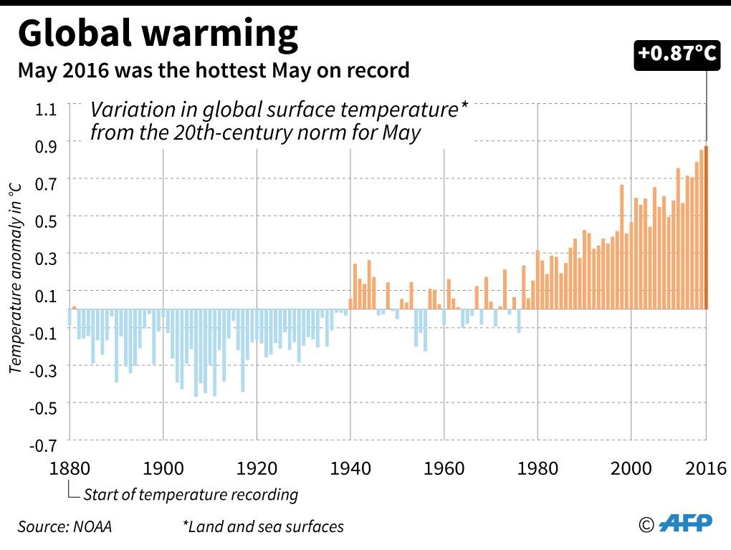
2. PROBLEM OVERVIEW
CARBON FOOTPRINTS Impacts
1. Rising temperatures
2. Soil Pollution
3. Aquatic life extinction
4. Health
5. Eco Friendly Product
in hospitals if in intensive care
The graph shows an increase in the temperature from 1880 to the year 2016, which is by far the hottest may, from the graph

Slide 7
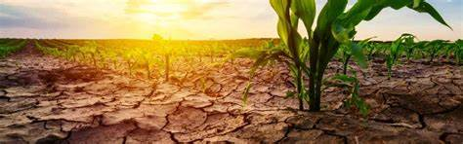
2. PROBLEM OVERVIEW
CARBON FOOTPRINTS Impacts
1. Rising temperatures
2. Drought
3. Aquatic life extinction
4. Health
5. Eco Friendly Product
in hospitals if in intensive care
Since the climate is changing this means there will be rains that will not be coming at their regular seasons

Slide 8
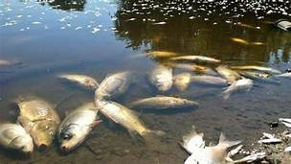
2. PROBLEM OVERVIEW
CARBON FOOTPRINTS Impacts
1. Rising temperatures
2. Soil Pollution
3. Aquatic life extinction
4. Health
5. Eco Friendly Product
in hospitals if in intensive care
80% of marine pollution originates on land, from human activities

Slide 9
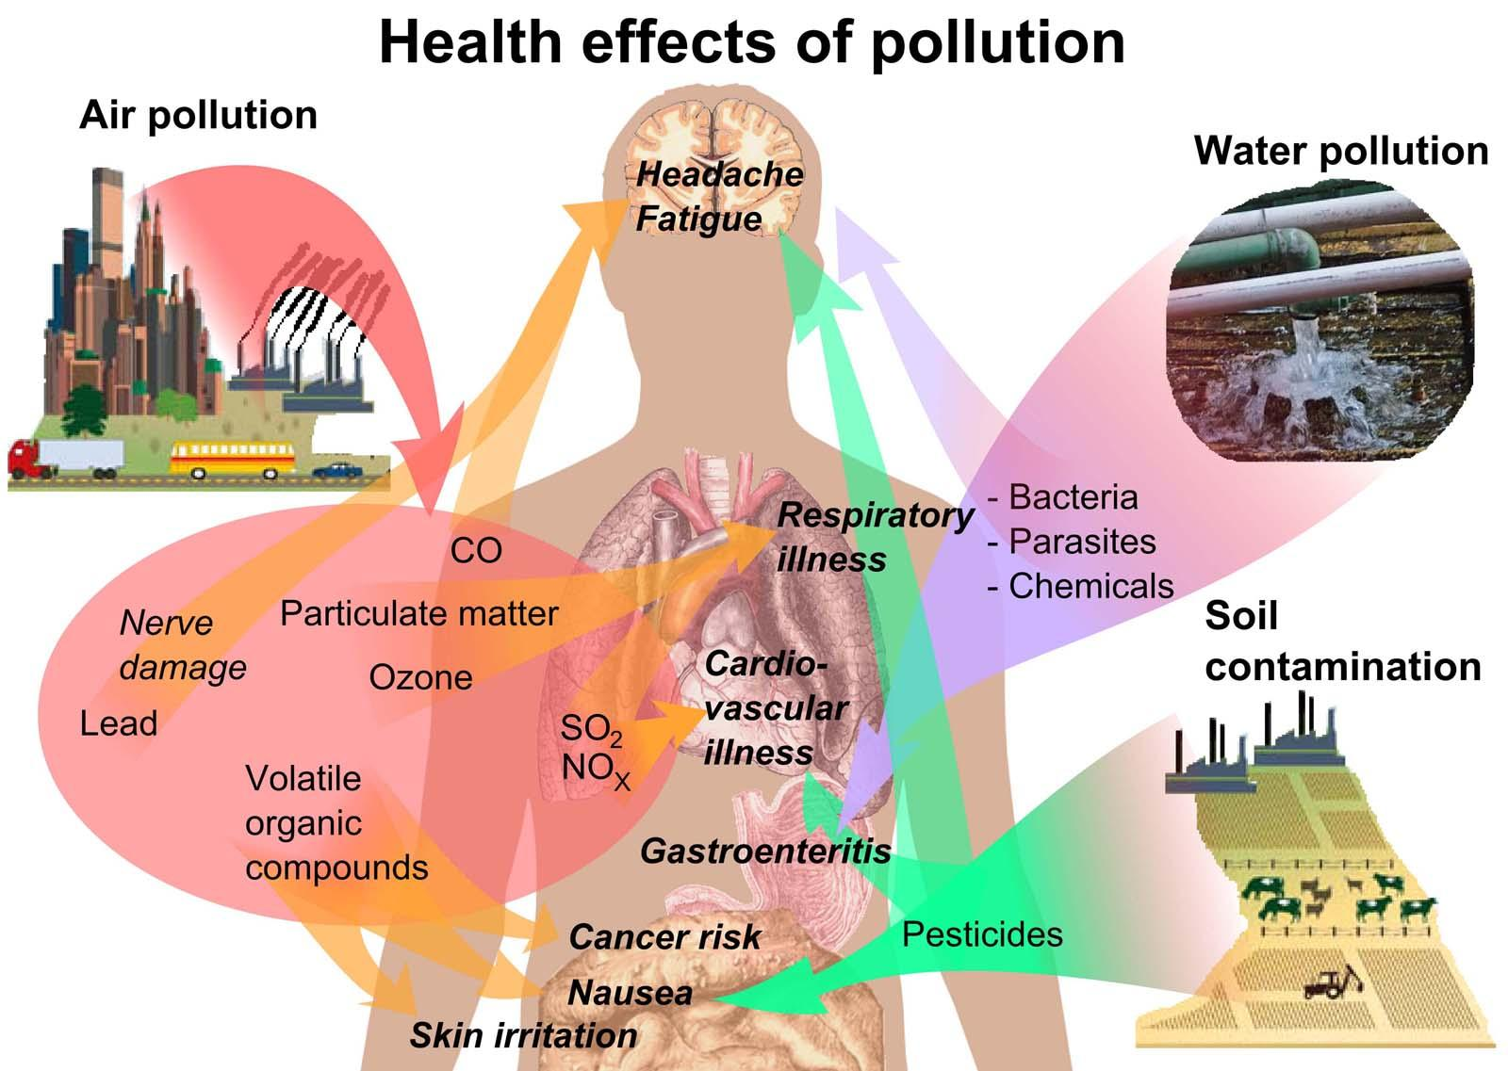
2. PROBLEM OVERVIEW
CARBON FOOTPRINTS Impacts
1. Rising temperatures
2. Soil Pollution
3. Aquatic life extinction
4. Health
5. Eco Friendly Product
in hospitals if in intensive care
Each and every type of pollution there is also contributes to the illness in it’s own way, from food, water and Air, this is a major problem

Slide 10




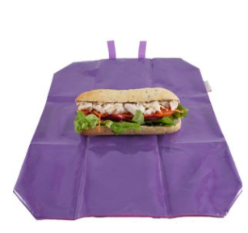
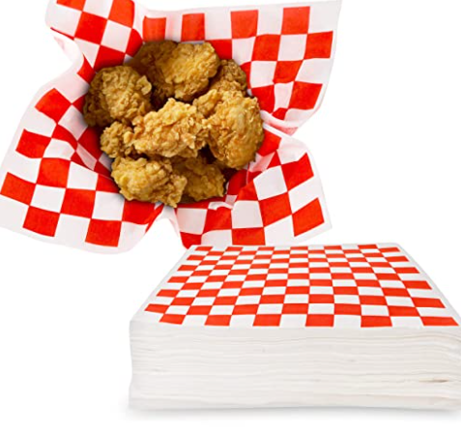
2. PROBLEM OVERVIEW
CARBON FOOTPRINTS Impacts
1. Rising temperatures
2. Soil Pollution
3. Aquatic life extinction
4. Health
5. Eco Friendly Product
. market
. sentiment predict
in hospitals if in intensive care
To join the fight in an eco friendly environment is as little as a reusable napkin but the rewards are huge

Slide 11







Data Science
Lifecycle
Business
Understanding
Data
Collection
Model
Deployment
Data
Preprocessing
Model
Evaluation
Data
Exploration (EDA)
Modelling
Data
Engineering

Slide 12
Natural Language Processing
Lifecycle
Data Preprocessing
Hyperparameter Tuning
Data Exploration (EDA)
Feature Text Engineering
Visualizing
Model Performance
Data Visualization
Feature Analysis
Data Cleaning
Normalizing
Vectorizing
Scaling
Imbalanced Data
GridSearchCV
Model Evaluation

Slide 13
Understanding Problem Statement
Missing Values
Missing Values
Translate Language
Machine Learning Techniques to translate language
Sentimental
Insights
Drawing insights from what people have twitted about climate change
Climate Change
All humans have the fundamental rights to live in a sustainable environment.

Slide 14
Number of Messages Per Sentiment
8000
6000
Count
4000
2000
Negative
Neutral
Positive
Factual
0
-1 0 1 2
Sentiment

Slide 15
Percentage of Messages per Sentiment
Negative
8.2%
Neutral
14.9%
Positive
53.9%
23.0%
Factual

Slide 16
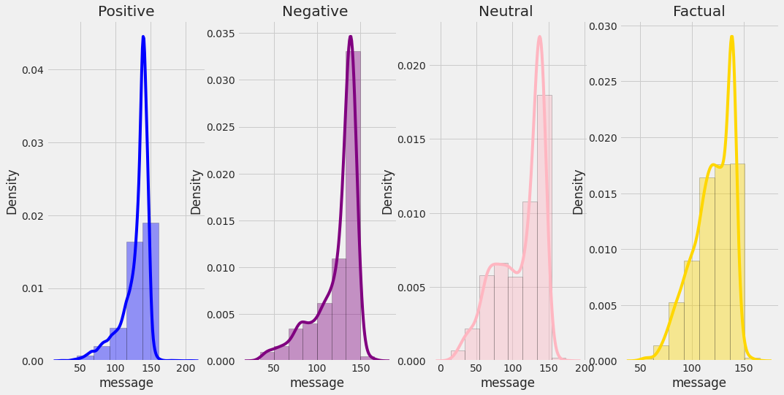
Distribution of Length per Label

Slide 17
Average Length of Messages by Sentiment
120
100
80
Length
60
40
20
Negative
Neutral
Positive
News
0
-1 0 1 2
Sentiment

Slide 18
Data Preprocessing
Data Cleaning
Tokenize
Stopwords
Stemming
Lemmitizing
Remove Noise
Tokens of strings
English Stopwords
Roor meaning of a word
Returning the dictionary meaning of a word

Slide 19
Data Preprocessing
Characters
Hashtags
URLs
Retweets
Mentions
Emojis
Punctuations
Remove [!*&%_-?\/.,<,>]
Data Cleaning
Numbers
Remove Numbers
Lower char
Transform to
lowercase characters

Slide 20

Data Preprocessing Example
‘PolySciMajor EPA chief doesn't think carbon dioxide is main cause of global warming and.. wait, what!? https://t.co/yeLvcEFXkC via @mashable’
polyscimajor epa chief doesnt think carbon dioxide is main cause of global warming and wait what urlweb via mashable
Data preprocessor

Slide 21
Data Normalization
Remove Stopwords
Tokenize
DataFrame
Lemitize
Stemming
Bag of words

Slide 22
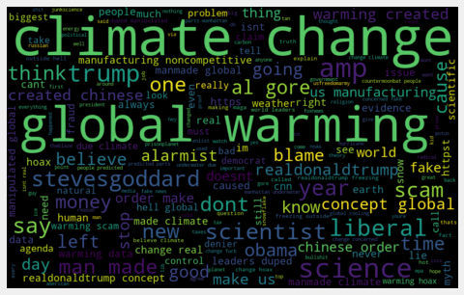
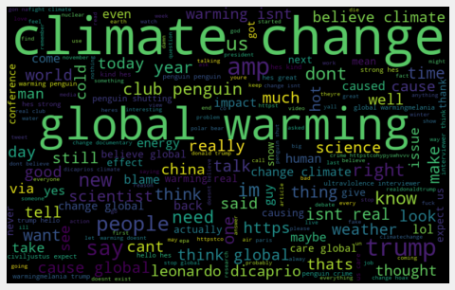
Further Text Exploration using wordcloud
Class -1 Class 0

Slide 23
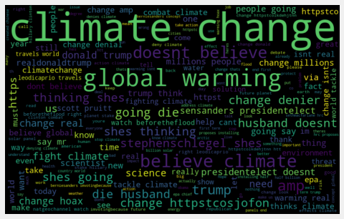
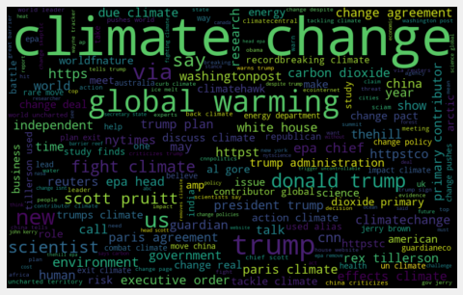
Further Text Exploration using wordcloud
Class 1 Class 2

Slide 24
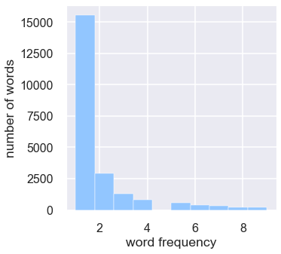
Distribution of words Appearing < 10

Slide 25
Frequent HashTags for all the classes

Slide 26
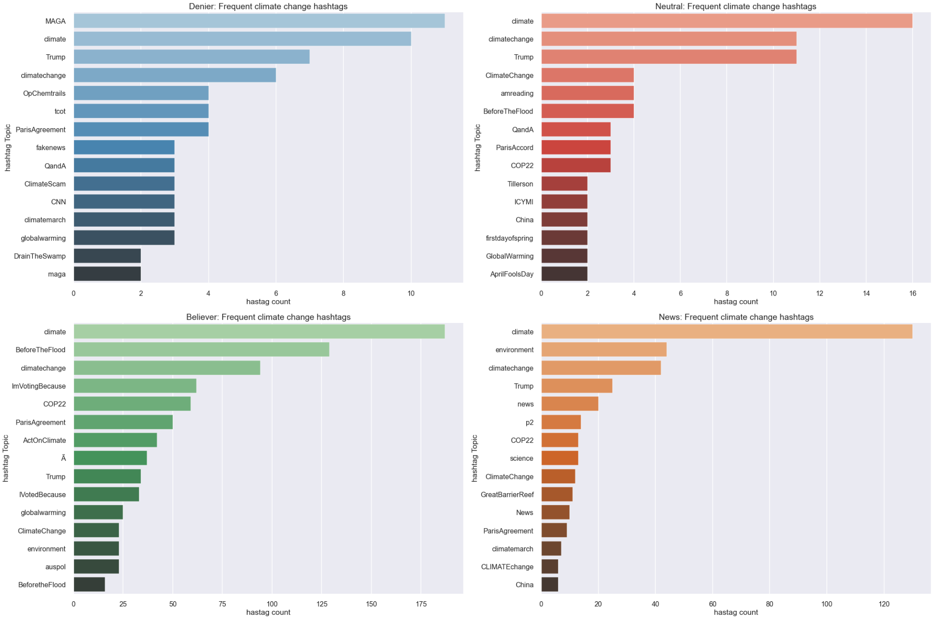

Slide 27
Data Preprocessing
192
Rear words
1205
Short Words

Slide 28
Experiments
LESS
NOISE
CLEAN SENTENCES
VS
STEMMED
CLEAN SENTENCES
LEMMATIZED
CLEAN
SENTENCES
CLEAN SENTENCES
VS
VS

Slide 29
Text Imbalance
8000
6000
Count
4000
2000
Negative
Neutral
Positive
Factual
0
-1 0 1 2
Sentiment
Models become better at predicting one class over the others.
Inherent predictive bias.

Slide 30
Upsampled Data
Downsampled Data
8000
8000
6000
Count
6000
4000
4000
2000
2000
Negativee
Neutral
Positive
Factual
Negative
Neutral
Positive
Factual
0
0
-1 0 1 2
-1 0 1 2
Sentiment
Sentiment
- Risk overfitting, can check against Test data.
- Generally better than downsampling
- Risk losing valuable information.
- Reduces dataset to a more manageable size.

Slide 31
Feature Text Engineering
Vectorizing
Cleaned Data
Scaling
Train Test Split

Slide 32
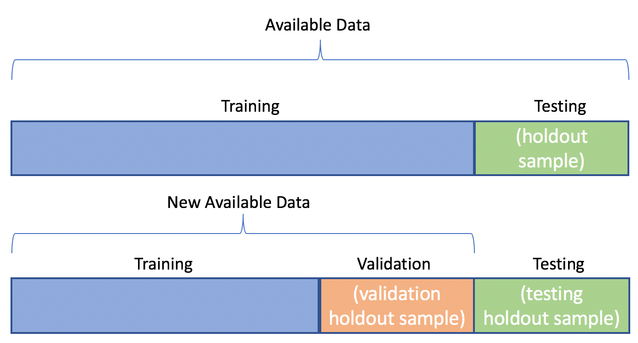
Train Test Split

Slide 33
Text Vectorisation
A document term matrix is generated and each column represents an individual unique word.
Each cell contains a weight value that signifies how important a word is for an individual text message or document.
Different from the count vectorization in the sense that it takes into considerations not just the occurrence of a word in a single document but in the entire corpus.
TF-IDF gives more weight to less frequently occurring events and less weight to expected events. So, it penalizes frequently occurring words that appear frequently in a document such as “the”, “is” but assigns greater weight to less frequent or rare words.

Slide 34
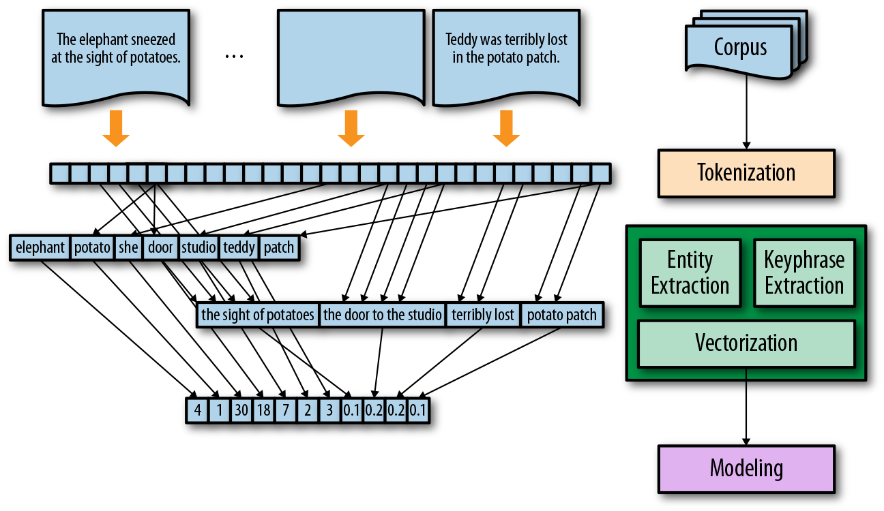
Text Vectorisation

Slide 35
Data Scaling
Min Absolute Scaler
Scale each feature by its maximum absolute value.
This estimator scales and translates each feature individually such that the maximal absolute value of each feature in the training set will be 1.0. It does not shift/center the data, and thus does not destroy any sparsity.
This scaler can also be applied to sparse matrices.

Slide 36

Modelling

Slide 37
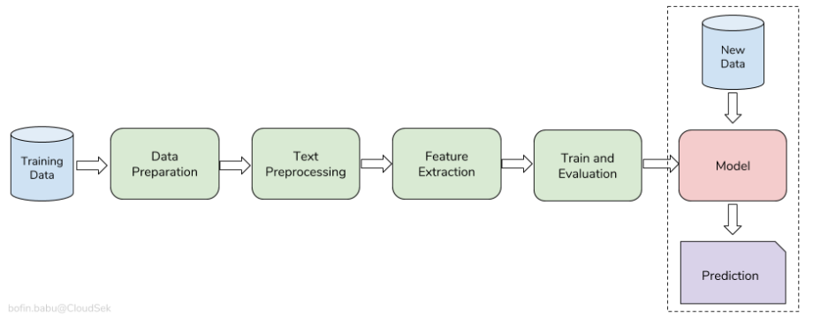
Modelling

Slide 38
Modelling

Slide 39
Classification Algorithms
Logistic Regression
Naive Bayes
Support Vector
K-Nearest Neighbor

Slide 40
4 Models Applied to our non Resampled dataset
90
Accuracy
80
60
Count
40
20
0
Logistic NB(Mult) SVC KNN
Reg. (Linear)
Classifiers

Slide 41
4 Models Applied to our Resampled(Upscaled) dataset
90
Accuracy
80
60
Count
40
20
0
Logistic NB(Mult) SVC KNN
Reg. (Linear)
Classifiers

Slide 42
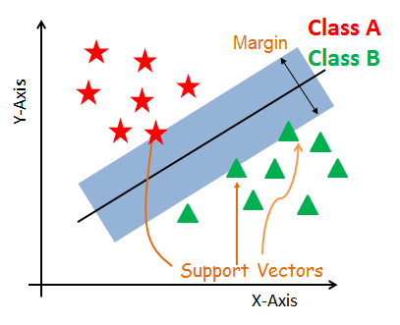
Support Vector Machine(SVM)
Kernel = ‘linear’

Slide 43
Support Vector Machine(SVM)
Support Vectors
Support vectors are the data points, which are closest to the hyperplane. These points will define the separating line better by calculating margins (n -1)
Hyperplane
A hyperplane is a decision plane which separates between a set of objects having different class memberships.
A kernel transforms an input data space into the required form.
Takes low-dimensional input space and transforms it into a higher dimensional space.

Slide 44
Logistic Regression
Used to model the probability of a certain class or event existing such as A/B
The dependent variable is finite or categorical: either A or B (binary regression) or a range of finite options A, B, C or D
In the multiclass case, the training algorithm uses the one-vs-rest (OvR) scheme if the ‘multi_class’ option is set to ‘ovr’

Slide 45

Logistic Regression Selected for our final submission on Kaggle
Logistic Regression
Mean F1 Score: 0.75167
Parameters:
C = 0.5
Multi_class = ‘ovr’

Slide 46


